Slide 1
Depression Classification Model

Slide 2
About Dataset :-
Shape of the dataset :- 170 rows × 13 columns
Feature Description:-
Interest Loss :- Reflects lack of motivation or engagement.
Hopelessness :- Indicates a potential decline in confidence and mental health.
Sleep Issues :- Highlights disruption in sleep patterns.
Low Energy :- Reflects physical manifestations of stress.
Appetite Changes :- Shows physical reactions to emotional stress.
Feeling Underprepared :- Links self-perception with external expectations.
Focus Issues :- Demonstrates cognitive difficulties under pressure.
Restlessness :- Reflects behavioral and physical agitation.
Life Worth :- Serious indicator of mental health distress.
Q1Score: Aggregate score of responses to all stress indicators.
DepSeverity: Classification of depression severity based on Q1Score.

Slide 3
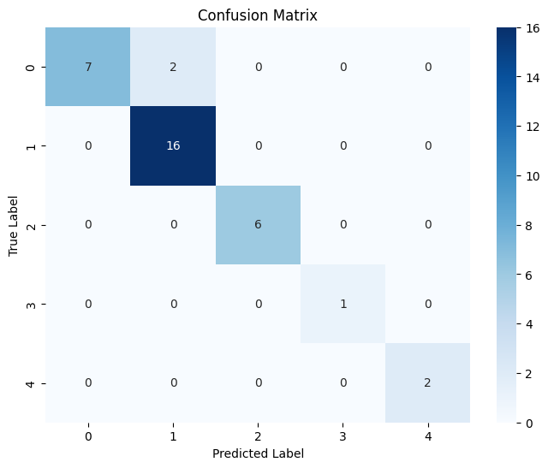
1. KNN
On Unbalanced Dataset
0-50 1-58 2-37 3-20 4-5
Confusion Matrix :-

Slide 4
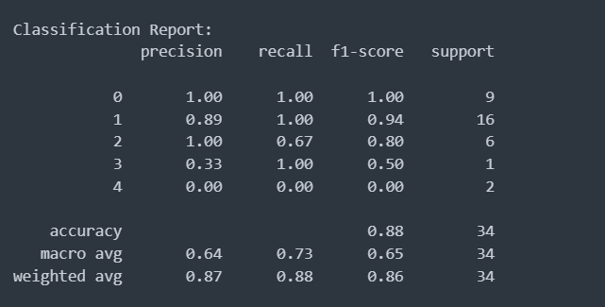
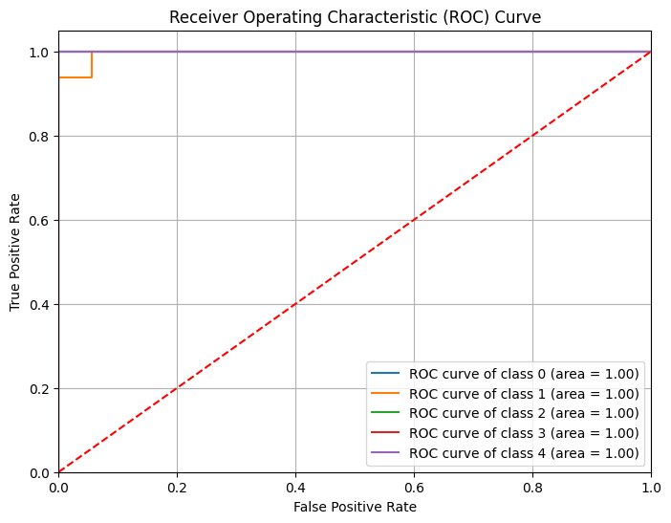
Classification Report :-
ROC Curve :-

Slide 5
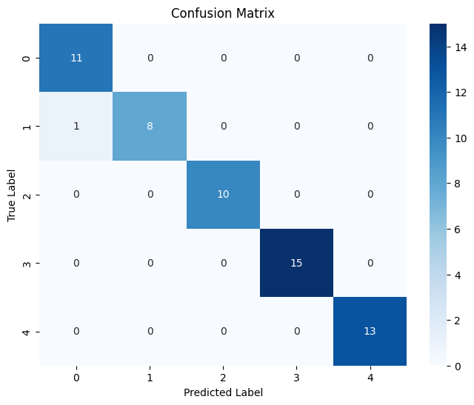
1. KNN
2) On balanced Dataset
Confusion Matrix :-

Slide 6
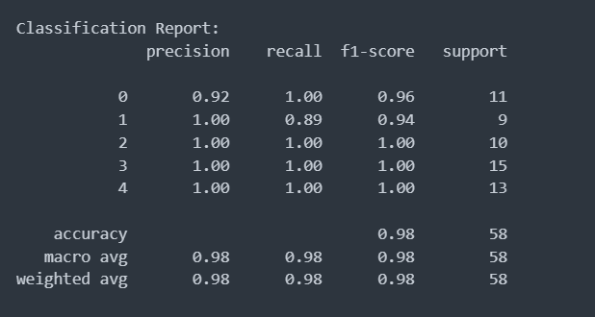
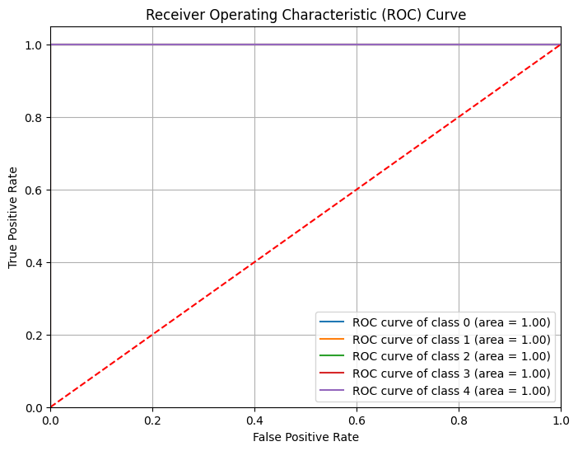
Classification Report :-
ROC Curve :-

Slide 7
2. Naïve Bayes
On Unbalanced Dataset
0-50 1-58 2-37 3-20 4-5
Confusion Matrix :-

Slide 8
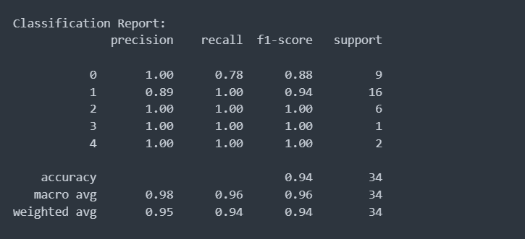
Classification Report :-
ROC Curve :-

Slide 9
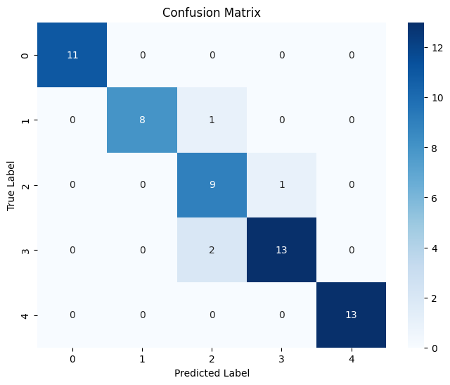
2. Naïve Bayes
On balanced Dataset
Confusion Matrix :-

Slide 10
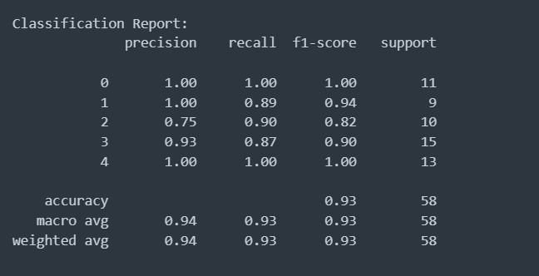
Classification Report :-
ROC Curve :-

Slide 11

3. Decision Tree CART
On Unbalanced Dataset
0-50 1-58 2-37 3-20 4-5
Confusion Matrix :-

Slide 12
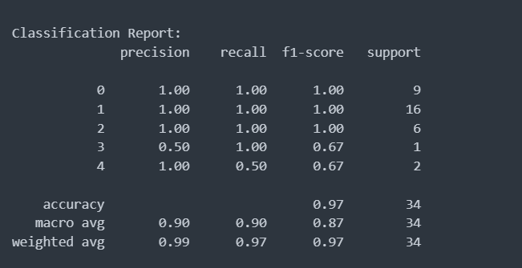
Classification Report :-
ROC Curve :-

Slide 13
3. Decision Tree CART
On balanced Dataset
Confusion Matrix :-

Slide 14
Classification Report :-
ROC Curve :-

Slide 15
4. Decision Tree ID3
On Unbalanced Dataset
0-50 1-58 2-37 3-20 4-5
Confusion Matrix :-

Slide 16
Classification Report :-
ROC Curve :-

Slide 17
4. Decision Tree ID3
On balanced Dataset
Confusion Matrix :-

Slide 18
Classification Report :-
ROC Curve :-

Slide 19
5. SVC
On Unbalanced Dataset
0-50 1-58 2-37 3-20 4-5
Confusion Matrix :-

Slide 20
Classification Report :-
ROC Curve :-

Slide 21
5. SVC
On balanced Dataset
Confusion Matrix :-

Slide 22
Classification Report :-
ROC Curve :-

Slide 23
6. Random Forest
On Unbalanced Dataset
0-50 1-58 2-37 3-20 4-5
Confusion Matrix :-

Slide 24
Classification Report :-
ROC Curve :-

Slide 25
6. Random Forest
On balanced Dataset
Confusion Matrix :-

Slide 26
Classification Report :-
ROC Curve :-

